Slide 1

Visual Basic
Semester Project
Suraj Mandal & Arnab Banerjee
BCA 1ST YEAR

Slide 2

What is Visual Basic?
Visual Basic is a third-generation event-driven programming language first released by Microsoft in 1991.
It evolved from the earlier DOS version called BASIC. BASIC means Beginners' All-purpose Symbolic Instruction Code. Since then Microsoft has released many versions of Visual Basic, from Visual Basic 1.0 to the final version Visual Basic 6.0.

Slide 3

What programs can you create with Visual Basic 6?
In VB 6, user can create any program
depending on your objective for example
Math professors can create mathematical programs such as Geometric Progression, Quadratic Equation Solver, Simultaneous Equation Solver and more for presentation.
Business can make applications for inventory management system , Amortization Calculator , investments calculator, etc for their organizations.
And so much more ...

Slide 4

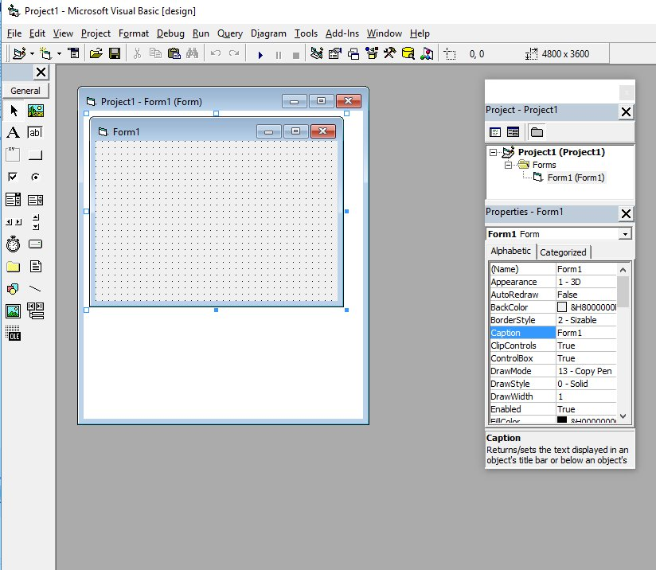
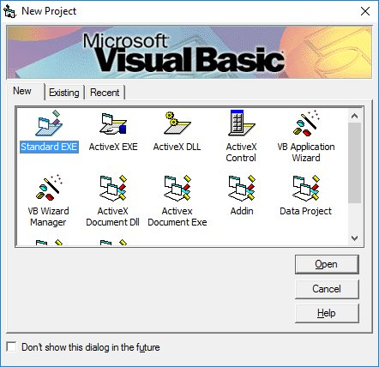

About VB 6.o IDE
When you start a new Visual Basic 6 Standard EXE project, you will be presented with the Visual Basic 6 Integrated Development Environment (IDE). The Visual Basic 6 Integrated Programming Environment consists of the toolbox, the form, the
project explorer and the properties window.
The Form is the primary building block of a Visual Basic 6 application. A Visual Basic 6 application can actually comprise many forms and elements.

Slide 5
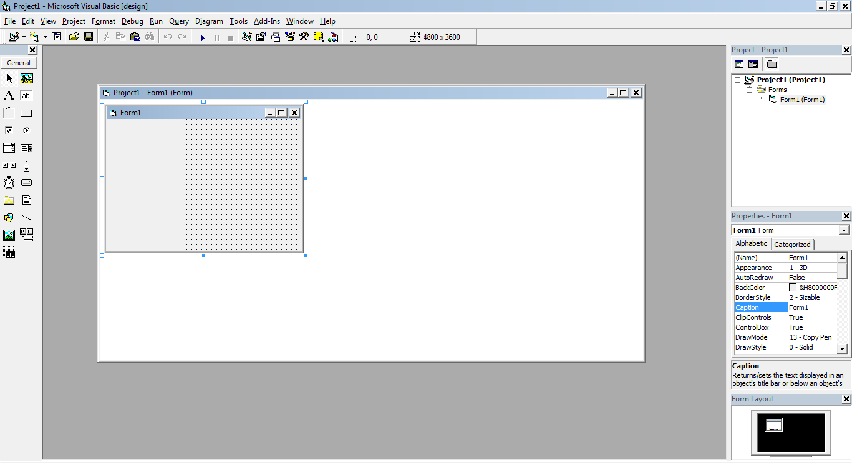
Title Bar
Menu Bar
Project Window
Form Window
Tool Bar
Properties Window
Properties Layout Window

Slide 6

Visual Basic Data Types
We come across all kinds of data in our daily life. For example, we need to handle data such as names, addresses, money, date, stock quotes, statistics and more every day. Similarly, in Visual Basic, we have to deal with all sorts of data, some can be mathematically calculated while some are in the form text or other forms. VB divides data into different types so that they are easier to manage when we need to write the code involving those data.

Slide 7

Numeric Data Types
Type | Storage
Byte | 1 byte
Integer | 2 bytes
Long | 4 bytes
Single | 4 bytes
Double | 8 bytes
Currency | 8 bytes
Decimal | 12 bytes

Slide 8
Non-numeric Data Types
Data Type | Storage
String(fixed length) | Length of string
String(variable length) | Length + 10 bytes
Date | 8 bytes
Boolean | 2 bytes
Object | 4 bytes
Variant(numeric) | 16 bytes
Variant(text) | Length+22 bytes

Slide 9

Operators in
Visual Basic
Table 6.1: Arithmetic Operators
Operator | Mathematical function | Example
^ | Exponential | 2^4=16
* | Multiplication | 4*3=12,
/ | Division | 12/4=3
Mod | Modulus (returns the remainder from an integer division) | 15 Mod 4=3
\ | Integer Division(discards the decimal places) | 19\4=4
+ or & | String concatenation | "Visual "&"Basic"="Visual Basic"

Slide 10

Conditional Operators
To control the VB program flow, we can use various conditional operators. Basically, they resemble mathematical operators. Conditional operators are very powerful tools, they let the VB program compare data values and then decide what action to take, whether to execute a program or terminate the program and more.
Conditional Operators
Operator | Meaning
= | Equal to
> | More than
< | Less Than
> = | More than or equal

Slide 11

Tic Tac Toe
Example project

Slide 12

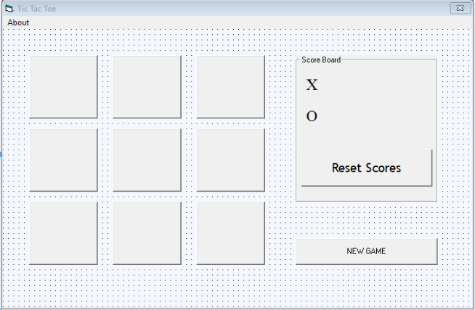
Design Window

Slide 13
Private Sub win()
If Command1(0).Caption = "X" And Command1(1).Caption = "X" And Command1(2).Caption = "X" Then MsgBox ("Player X Wins!")
Command10_Click
Label2.Caption = Val(Label2.Caption) + Val(1)
End If
If Command1(3).Caption = "X" And Command1(4).Caption = "X" And Command1(5).Caption = "X" Then
MsgBox ("Player X Wins!")
Command10_Click
Label2.Caption = Val(Label2.Caption) + Val(1)
End If
If Command1(6).Caption = "X" And Command1(7).Caption = "X" And Command1(8).Caption = "X" Then
MsgBox ("Player X Wins!")
Command10_Click
Label2.Caption = Val(Label2.Caption) + Val(1)
End If
If Command1(0).Caption = "X" And Command1(3).Caption = "X" And Command1(6).Caption = "X" Then
MsgBox ("Player X Wins!")
Command10_Click
Label2.Caption = Val(Label2.Caption) + Val(1)
End If
If Command1(1).Caption = "X" And Command1(4).Caption = "X" And Command1(7).Caption = "X“ Then
MsgBox ("Player X Wins!")
Command10_Click
Label2.Caption = Val(Label2.Caption) + Val(1
End If
If Command1(2).Caption = "X" And Command1(5).Caption = "X" And Command1(8).Caption = "X" Then
MsgBox ("Player X Wins!")
Command10_Click
Label2.Caption = Val(Label2.Caption) + Val(1)
End If
If Command1(0).Caption = "X" And Command1(4).Caption = "X" And Command1(8).Caption = "X" Then
MsgBox ("Player X Wins!")
Command10_Click
Label2.Caption = Val(Label2.Caption) + Val(1)
End If
If Command1(2).Caption = "X" And Command1(4).Caption = "X" And Command1(6).Caption = "X" Then
MsgBox ("Player X Wins!")
Command10_Click
Label2.Caption = Val(Label2.Caption) + Val(1)
End If

Slide 14
If Command1(0).Caption = "O" And Command1(1).Caption = "O" And Command1(2).Caption = "O" Then
MsgBox ("Player O Wins!")
Command10_Click
Label4.Caption = Val(Label4.Caption) + Val(1)
End If
If Command1(3).Caption = "O" And Command1(4).Caption = "O" And Command1(5).Caption = "O" Then
MsgBox ("Player O Wins!")
Command10_Click
Label4.Caption = Val(Label4.Caption) + Val(1)
End If
If Command1(6).Caption = "O" And Command1(7).Caption = "O" And Command1(8).Caption = "O" Then
MsgBox ("Player O Wins!")
Command10_Click
Label4.Caption = Val(Label4.Caption) + Val(1)
End If
If Command1(0).Caption = "O" And Command1(3).Caption = "O" And Command1(6).Caption = "O" Then
MsgBox ("Player O Wins!")
Command10_Click
Label4.Caption = Val(Label4.Caption) + Val(1)
End If
If Command1(1).Caption = "O" And Command1(4).Caption = "O" And Command1(7).Caption = "O" Then
MsgBox ("Player O Wins!")
Command10_Click
Label4.Caption = Val(Label4.Caption) + Val(1)
End If
If Command1(2).Caption = "O" And Command1(5).Caption = "O" And Command1(8).Caption = "O" Then
MsgBox ("Player O Wins!")
Command10_Click
Label4.Caption = Val(Label4.Caption) + Val(1) End If
If Command1(0).Caption = "O" And Command1(4).Caption = "O" And Command1(8).Caption = "O" Then
MsgBox ("Player O Wins!")
Command10_Click Label4.Caption = Val(Label4.Caption) + Val(1)
End If
If Command1(2).Caption = "O" And Command1(1).Caption = "O" And Command1(6).Caption = "O" Then
MsgBox ("Player O Wins!")
Command10_Click
Label4.Caption = Val(Label4.Caption) + Val(1)
End If
End Sub

Slide 15

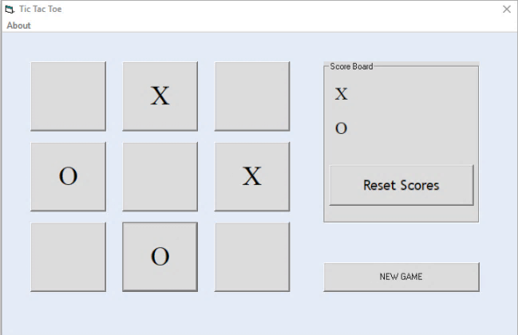
Output window

Slide 16
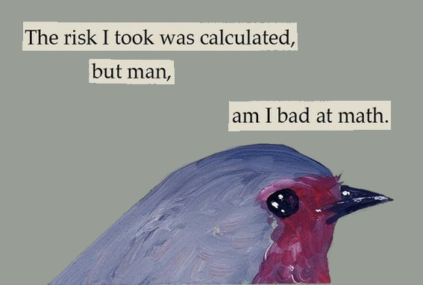
Calculator
Example program #2

Slide 17

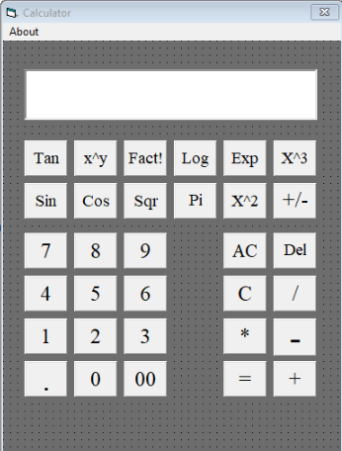
Calculator

Slide 18
Codes for The Program
Dim i x, y, dflag, opnre, oflag, ind, j, w, As Integer
Dim prev As Double
Private Sub About_Click()
MsgBox ("This application was build for demonstration purposes only Designed and Developed by Arnab Banerjee")
End Sub
Private Sub Command1_Click(Index As Integer)
If ind = 4 Then
prev = 0
Text1.Text = " "
ind = 0
End If
opnre = 0
If oflag = 0 Then
Text1.Text = " "
End If
oflag = 1
If Command1(Index).Caption <> "." Then
If Text1.Text <> " 0" Then
Text1.Text = Text1.Text & Command1(Index).Caption
Else Text1.Text = " " & Command1(Index).Caption
End If
Else If
dflag = 0
Then
Text1.Text = Text1.Text & "."
dflag = 1
Else
MsgBox ("ILLEGAL SAIRAM")
End If
End If
End Sub
Private Sub Command2_Click(Index As Integer)
Text1.Text = 3.141592654
End Sub
Private Sub Command3_Click()
Text1.Text = " 0"
End Sub
Private Sub Command4_Click()
dflag = 0
prev = 0
oflag = 0
ind = 0
opnre = 0
Text1.Text = " 0"
End Sub
Private Sub Command8_Click()
If Len(Text1.Text) > 0 Then
Text1.Text = Right$(Text1.Text, Len(Text1) - 1)
End If
End Sub
Private Sub Form_Load()
' standard.Height = 4090
' standard.Width = 3430
dflag = 0
prev = 0
oflag = 0
ind = 0
opnre = 0
End Sub
Private Function facts(i)
f = 1
For j = 1 To w
f = f * j
facts = f
Next j
End Function

Slide 19
Private Sub Command5_Click(Index As Integer)
If opnre = 0 Or Index = 4 Then
If ind = 0 Then
prev = prev + Val(Text1.Text)
ElseIf ind = 3 Then
prev = prev - Val(Text1.Text)
ElseIf ind = 1 Then
If Val(Text1.Text) = 0 Then
MsgBox ("SORRY DIVIDE ZERO")
Exit Sub Else prev = prev / Val(Text1.Text)
End If
ElseIf ind = 2 Then
prev = prev * Val(Text1.Text)
End If
Text1.Text = Str(prev)
oflag = 0
End If
opnre = 1
ind = Index
dflag = 0
End Sub
Private Sub
Command7_Click(Index As Integer)
Select Case Index
Case 0
Text1.Text = Math.Sin(Val(Text1.Text) * 3.14159265358979 / 180)
Case 9
Text1.Text = Math.Cos(Val(Text1.Text) * 3.14159265358979 / 180)
Case 8
Text1.Text = Math.Tan(Val(Text1.Text) * 3.14159265358979 / 180)
Case 4
w = Val(Text1.Text)
Text1.Text = facts(w)
Case 2
Text1.Text = Math.Sqr(Val(Text1.Text))
Case 5
Text1.Text = Text1.Text * Text1.Text
Case 1
Text1.Text = Text1.Text * Text1.Text * Text1.Text
Case 6 Text1.Text = Math.Exp(Val(Text1.Text))
Case 7
If Val(Text1.Text) > 0 Then
Text1.Text = ((Math.Log(Val(Text1.Text)) * 0.434294481903252))
Else
MsgBox (" ILLEGAL. LOG NON POSITIVE ")
End If
End Select
End Sub
Private Sub Command6_Click()
Text1.Text = Str(Val(Text1.Text) * -1)
End Sub

Slide 20

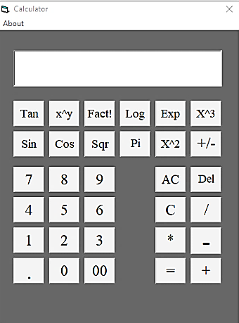
Program Output

Slide 21




Thank You

